Slide 1




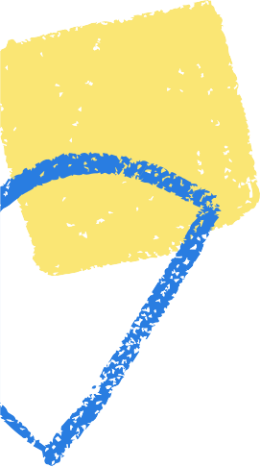




Semantic tableaux
BULAt JACLINA-IANA

Slide 2





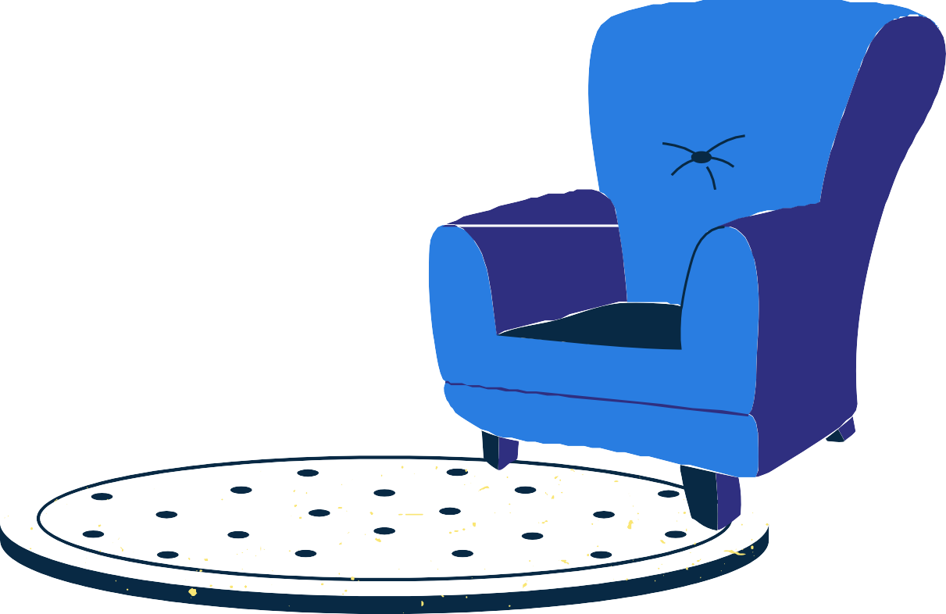



Chapters
CHAPTER 1 : THEORy CHAPTER 2 : SOLUTION CHAPTER 3 : CONCLUSION

Slide 3





CHAPTER 1
THEORy

Slide 4













Theory of Semantic Tableaux
We use the semantic tableaux method when we need to use a SEMANTIC PROOF METHOD with a PROPOSITIONAL/PREDICATE LOGIC and it is classified as a REFUTATION PROOF METHOD
It was adapted to nonstardad logics and it is based on semantic considerations, it aims to decide consistency and to find all the models of a formula by decomposing it into subformulas
The validity of a formula is proved by CONTRADICTION -> refutation method

Slide 5










How we construct a semantic tableaux
FORMULA HERE
To a formula U we can associate a semantic tableaux, which is a binary tree having formulas in its nodes and it builts following the next steps :
(ROOT)
STEP 1 : the root of the tree is labeled with the initial formula

Slide 6









How we construct a semantic tableaux
STEP 2 : Every branch of the tree which
FORMULA HERE
contains a formula will be extended with a subtree according to the decomposition rule specific to its class
SUBFORMULA
SUBFORMULA
SUBSUBFORMULA
SUBSUBFORMULAS
SUBSUBSUBFORMULA

Slide 7
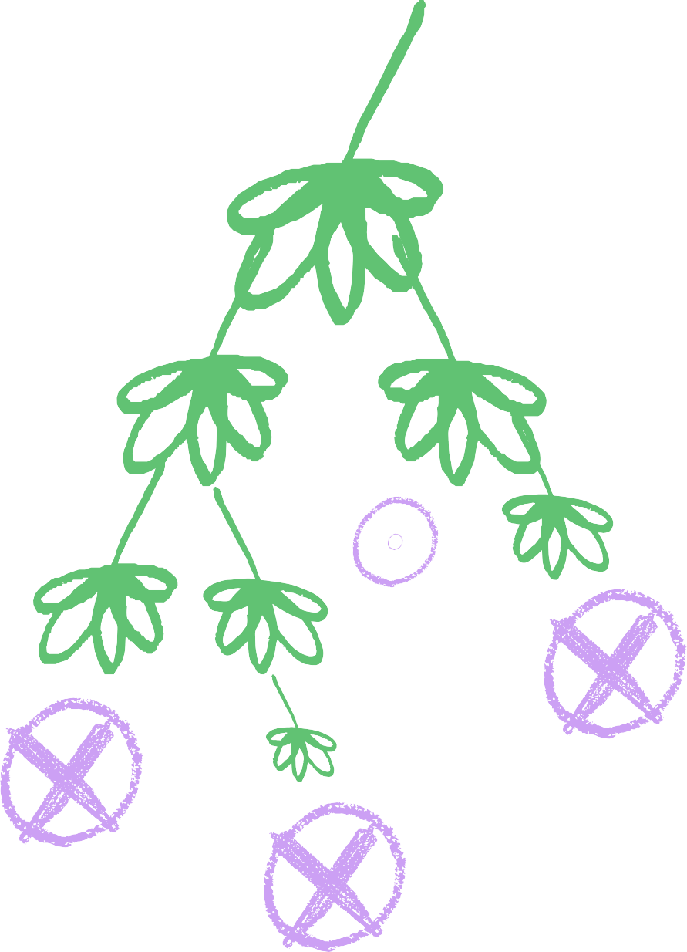

How we construct a semantic tableaux
STEP 3 : the extentions of the branches stop in the following cases :
CASE A(manda) : if that branch contains a formula and its negotiation, the branch is marked as closed
CASE B(ruh) : if all the formulas are
already decomposed or if by decomposing the formulas which are not decomposed yet, no new formulas are obtained
FORMULA HERE
SUBFORMULA
SUBFORMULA
SUBSUBFORMULA
SUBSUBFORMULAS
SUBSUBSUBFORMULA

Slide 8



CHAPTER 2
SOLUTION

Slide 9











EXERCISE 2
PROVE THAT THE FOLLOWING FORMULAS ARE TAUTOLOGIES USING THE SEMANTIC TABLEAUX METHOD:
1. DISTRIBUTION OF '->’ OVER „/\”:
(P -> Q /\ R) <-> ((P->Q) /\ (P->R))

Slide 10
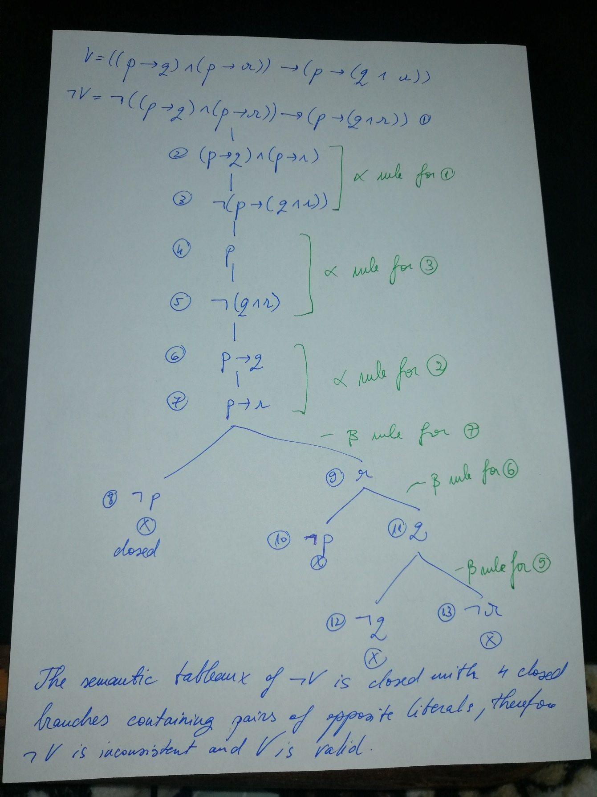
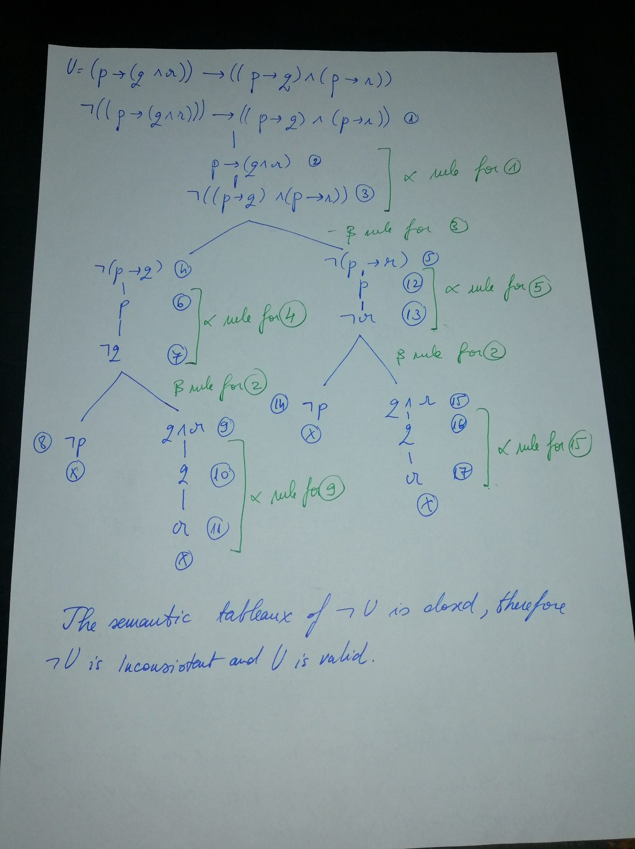




Slide 11
Since U and V are valid, then the distribution of „->” over „/\” formula is a tautology

Slide 12

CHAPTER 3
CONCLUSION

Slide 13




Conclusion
The Semantic Tableaux method is a refutation proof method meaning: you have a theory X, then if the opposite of theory X is false, theory X is true
MAy WE HAVE FUN AND PRODUCTIVE LEARNING SESSIONS.
SIGNED - BLU

